Slide 1
4.5 Graphs of Sine and Cosine Functions
Sketch graphs of sine and cosine functions
Sketch graphs of sine and cosine functions with amplitude and period changes.
Sketch graphs of sine and cosine functions with horizontal and vertical shifts.
Use sine and cosine functions to model real-life data.

Slide 2
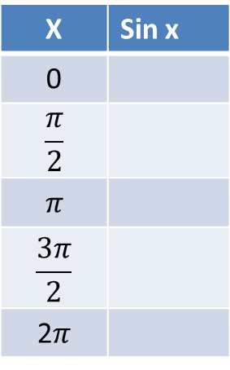

Graph of sine function
$$y=\sin{x}$$
Note that the period is $2π$
X | Sin x
0
$$\frac{π}{2}$$
$$π$$
$$\frac{3π}{2}$$
2$π$

Slide 3
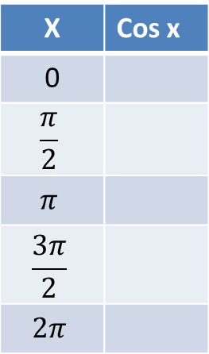

Graph of Cosine Function
$$y=\cos{x}$$
Note that the period is $2π$
X | Cos x
0
$$\frac{π}{2}$$
$$π$$
$$\frac{3π}{2}$$
$$2π$$

Slide 4
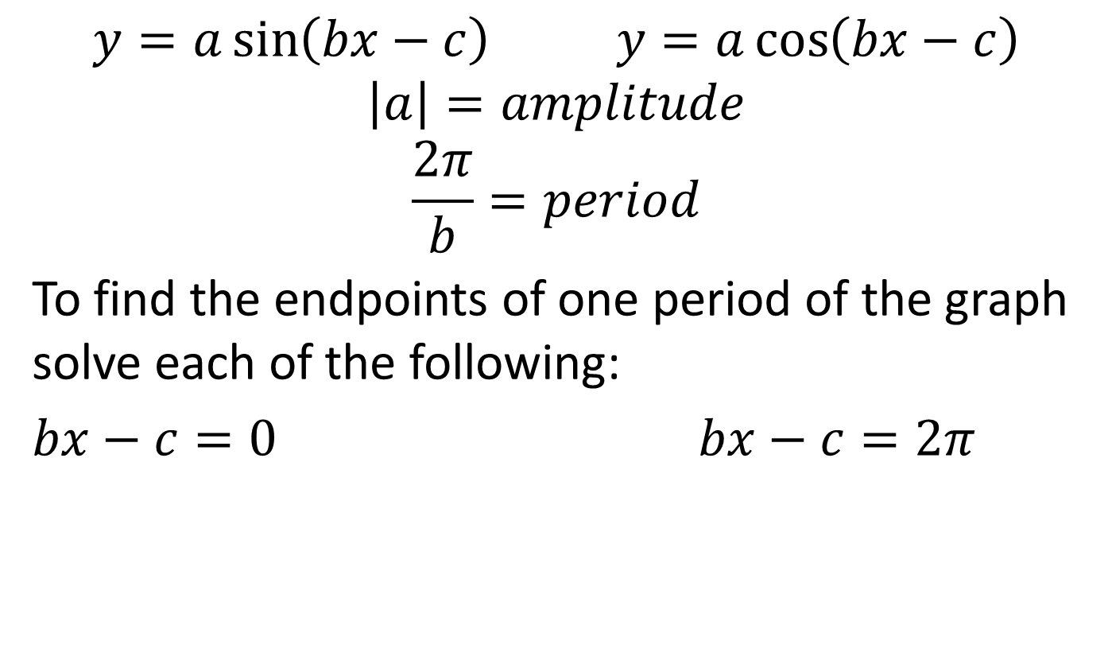
Sine and cosine functions with amplitude and period changes
$$y=a\sin\left(bx−c\right) y=a\cos\left(bx−c\right)$$
$$\left|a\right|=amplitude$$
$$\frac{2π}{b}=period$$
To find the endpoints of one period of the graph solve each of the following:
$bx−c=0$ $bx−c=2π$

Slide 5

Sine function with amplitude and period changes
Example: sketch the graph of $y=3\sin{x}$
$$y=2\cos{\frac{x}{4}}$$

Slide 6

Graphs of sin and cos
State the amplitude and period for each. Then graph two complete periods.
$$y=−2\sin{2x}$$

Slide 7

Graphs of sin and cos
$$y=−\frac{3}{2}\cos{\frac{2x}{3}}$$

Slide 8
Homework 4.5
Page 328
1-13, 35-43 odd

Slide 9

Translations of sine functions
Horizontal shifts: (phase shift)
find the endpoints of the period and use amplitude and period as before.
$$y=−\sin\left(2x+π\right)$$

Slide 10

Phase shifts
$$y=2\cos\left(\frac{x}{2}−3π\right)$$

Slide 11

Translations of sine functions
Vertical shifts: In the equation $y=d+a\sin\left(bx−c\right)$, d is the vertical shift.
Start by graphing the midline $y=d$
Then complete the graph as before.
$$y=−3+2\sin{x}$$

Slide 12

Vertical Shift and Horizontal Shift
$$y=5−3\cos\left(2x+2π\right)$$

Slide 13
Homework 4.5
Page 329
44-56 all

